Slide 1
PART-3

Slide 2

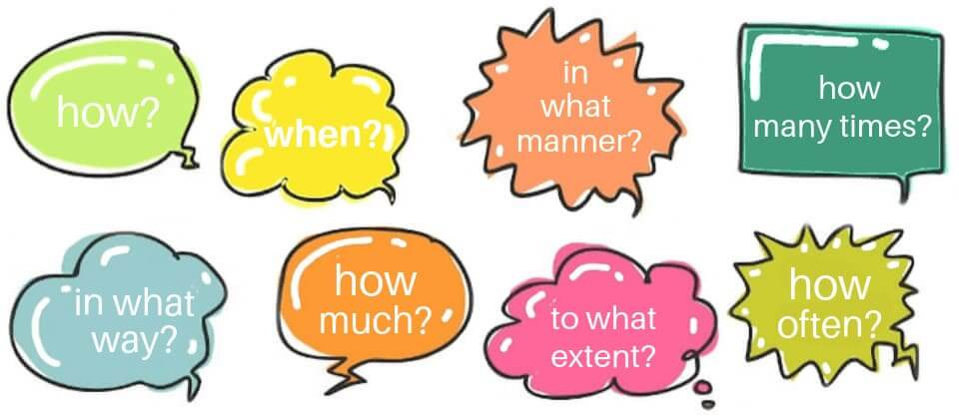
ADVERB
Adverbs describe verbs and modify adjectives and other adverbs. Adverbs, unlike adjectives, do not modify nouns. Adverbs can also modify phrases, clauses, and sentences. Adverbs answer one of the following questions: When? Where? Why? How? Under what conditions? and To what extent?

Slide 3
For Example:-
The teacher had to speak loudly to be heard over the children. (Loudly modifies the verb speak.)
The children were really bad during the movie. (Really modifies the adjective bad.)
John approached the wounded dog very slowly. (Very modifies the adverb slowly.)
Clearly, Sarah did not understand the directions. (Clearly modifies the sentence.)
The box is still below the stairs. (Still modifies the phrase “below the stairs.”)

Slide 4
Poll Question:-
Adverbs can describe_____, ______, & ______.
A. nouns, verbs, adjectives
B. verbs, adjectives, adverbs
C. pronouns, verbs, adjectives
D. verbs, adverbs, nouns

Slide 5
Answer
OPTION- B

Slide 6
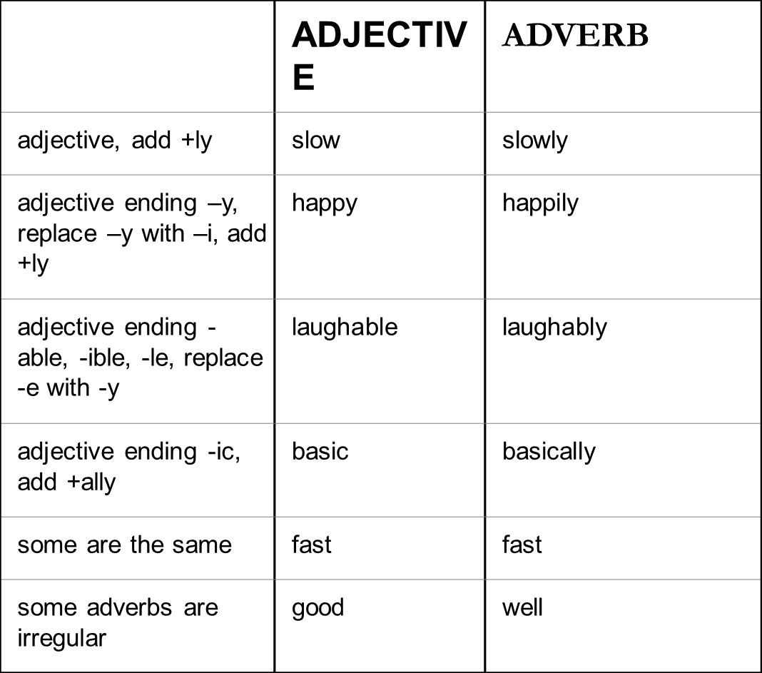
HOW TO FORM ADVERBS
Adverbs are often formed by adding -ly to an adjective:
slow – slowly weak – weakly frequent – frequently
although there are many exceptions and irregulars, for example:

Slide 7
Activity
Make the following into adverbs slow lucky fast economic early

Slide 8
Poll Question
Adverbs can modify all of the following, except a. verbs b. adjectives c. other adverbs d. conjunctions

Slide 9
Answer
OPTION-D

Slide 10

Adverb of MANNER
Adverb of TIME
Adverb of PLACE
Adverb of FREQUENCY
Adverb of DEGREE

Slide 11
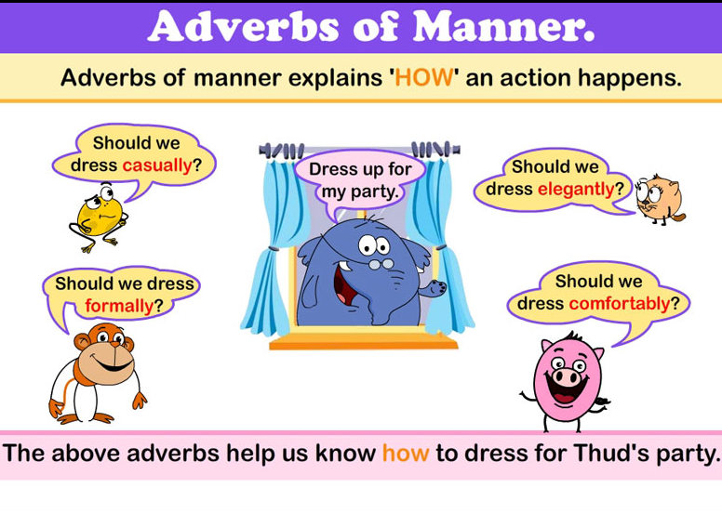
Adverb of MANNER
An adverb of manner answers the question How?
Adverbs of manner include badly, beautifully, better, bravely, cheerfully, fast, hard, quickly, slowly, inadequately, healthy, well, etc.

Slide 12
Examples:-
Sarah slowly walked over the rocky beach.
(Slowly answers the question: How did Sarah walk?)
.
If there is a direct object in the sentence, the adverb of manner comes after it, and not straight after the verb:
The child petted her dog lovingly. The artist painted the model beautifully.

Slide 13
Poll Question
Which of the following is not an adverb?
A. hard
B. friendly
C. fast
D. well

Slide 14
Answer
OPTION-B

Slide 15
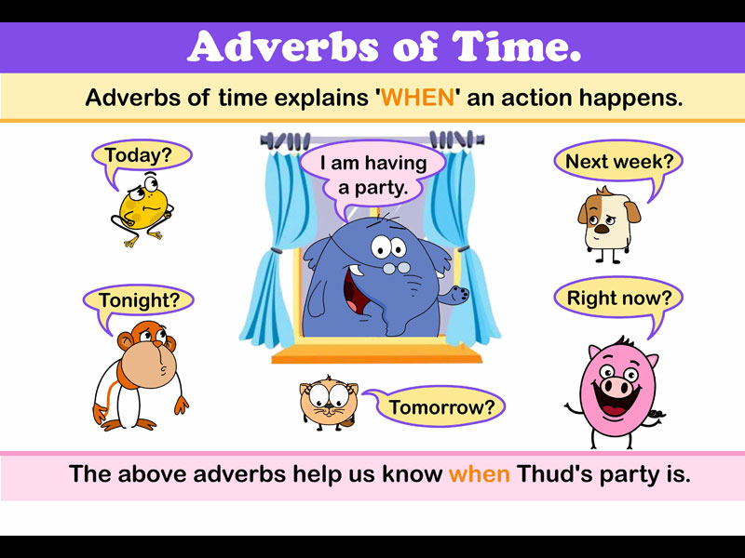
Adverb of TIME
An adverb of time answers the question When?
Adverbs of time include after, always, before, during, early, later, never, now, often, rarely, recently, sometimes, soon, then, today, tomorrow, usually, yesterday, etc.

Slide 16
Examples:-
John will attend the soccer game after he finishes his homework.
(After answers the question: When will John attend the soccer game?)
An adverb of time may be found at the beginning or end of a sentence, before or after the main verb.
Yesterday the sun shone and there was not a cloud in the sky. He will come round later.
The position of the adverb of time at the beginning of the sentence puts emphasis on the time.

Slide 17
Poll Question
Adverbs of time answer all of these questions, except a. when b. for how long c. why d. how often

Slide 18
Answer
OPTION- C

Slide 19
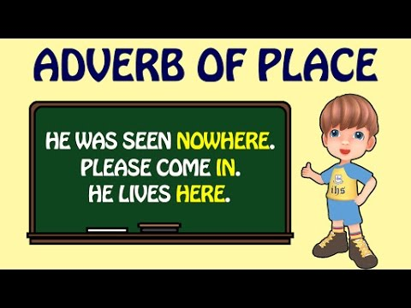
Adverb of PLACE
An adverb of place answers the question Where?
Adverbs of place include above, away, below, down, here, inside, near, outside, there, up, etc.

Slide 20
For Example:-
Susan placed the boxes above the file cabinet.
(Above answers the question: Where did Susan place the boxes?)
An adverb of place is almost always placed after the verb. They are not used to modify adjectives or other adverbs.
John looked everywhere for his lost keys. The boys were playing outside.
Note – many adverbs of place are also prepositions of place – when used as prepositions they are followed by a noun.

Slide 21
Poll Question
Identify the adverb of place.
I looked everywhere for my lost book.
A. lost
B. I
C. everywhere
D. looked

Slide 22
Answer
OPTION-C

Slide 23
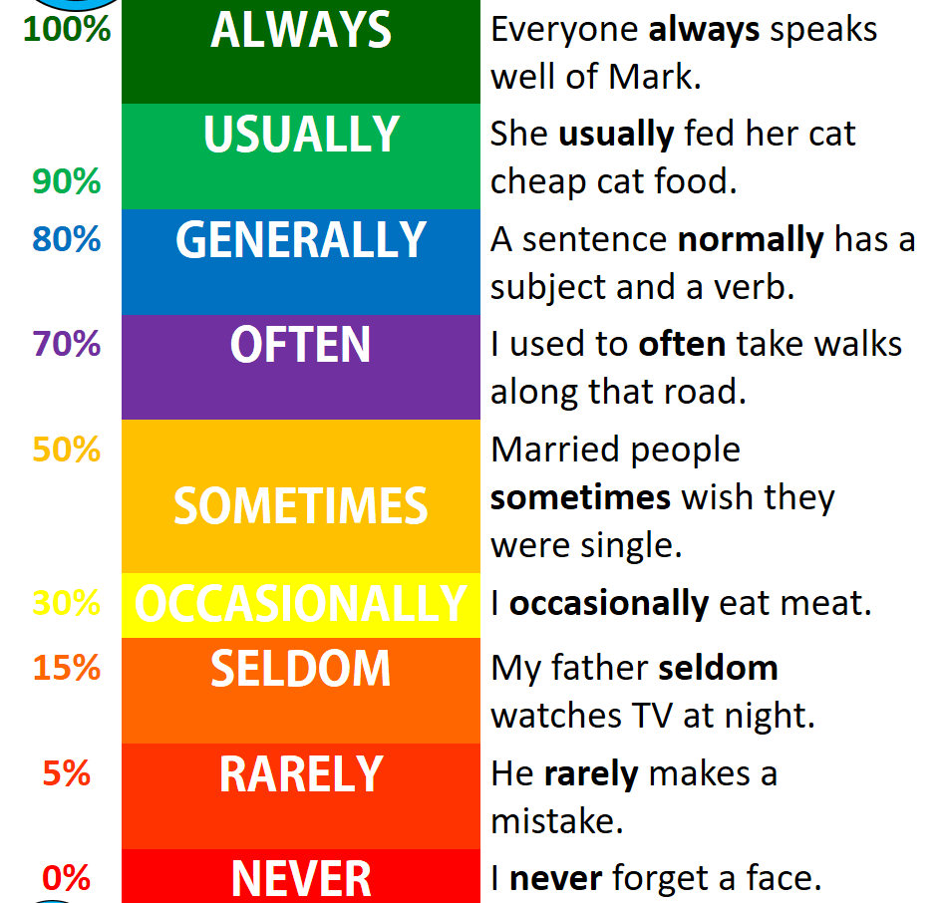
Adverb of FREQUENCY
An adverb of frequency answers the question How often?
Adverbs of frequency include always, never, usually, frequently, occasionally, rarely, seldom, sometimes, etc.

Slide 24
For Example:-
Bob always forgets to check his email before class begins.
(Before answers the question: How often does Bob forget to check his email?)
An adverb of frequency is mostly placed before the verb.
He rarely visits his mother. She always forgets her books.
exceptions are the more specific adverbs daily, fortnightly, yearly, annually
The menu changes daily.

Slide 25


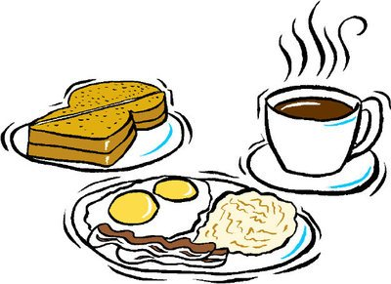

Poll Question- Choose the correct option.
He (0%) drinks coffee.
A. He sometimes drinks coffee.
B. He never drinks coffee.
C. He always drinks coffee
D. He often drinks coffee.

Slide 26
Answer
OPTION- B

Slide 27
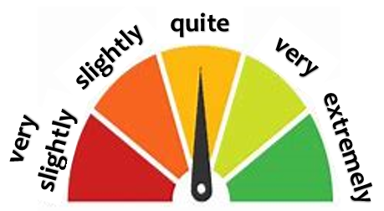
Adverb of DEGREE
An adverb of degree answers the question How much? It describes the strength and intensity at which something happens.
Adverbs of degree include almost, completely, enough, entirely, extremely, hardly, just, little, much, nearly, quiet, rather, very, too, etc.

Slide 28
Examples:-
John worked very hard to complete his part of the project.
(Very answers the question: How hard did John work?)
An adverb of DEGREE will often come before the word they are modifying.
The exam was extremely easy. It was barely raining. It was very interesting to live in Japan for a year.

Slide 29
Poll Question
When do we use ADVERBS OF DEGREE?
A. We use them to show the intensity or degree of a noun.
B. We use them to show the intensity or degree of an action.

Slide 30
Answer
OPTION- B

Slide 31
HOW TO USE ADVERBS
with verbs in many cases they can come before or after the verb. If they come before the verb they generally add more emphasis: He ate his lunch quickly. He quickly ate his lunch.
with adjectives they often make the adjective stronger or weaker. She was hugely overweight She is very tall.
with other adverbs they change the degree of intensity He ran too slowly. She was talking very quickly.

Slide 32
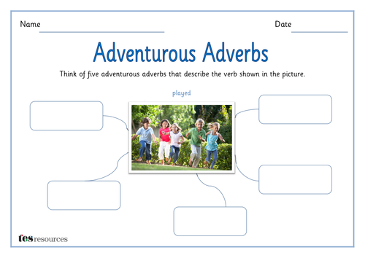
Activity

Slide 33
PREPOSITION

Slide 34
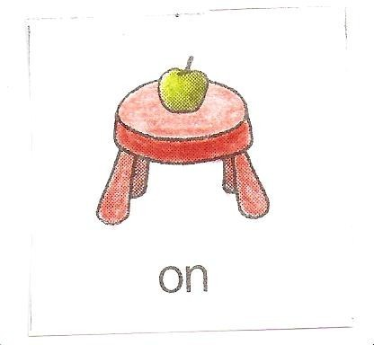
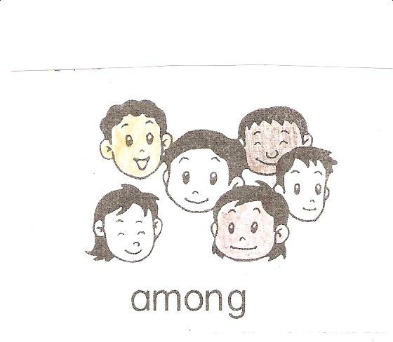
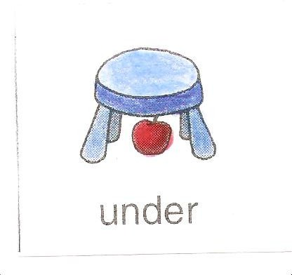
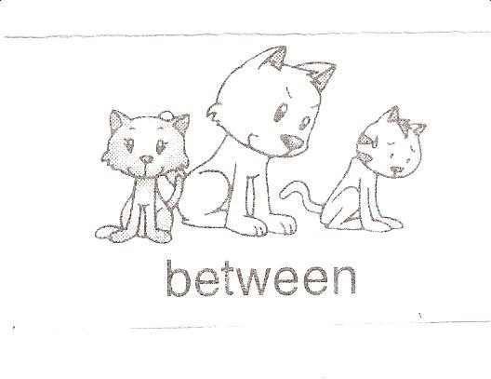
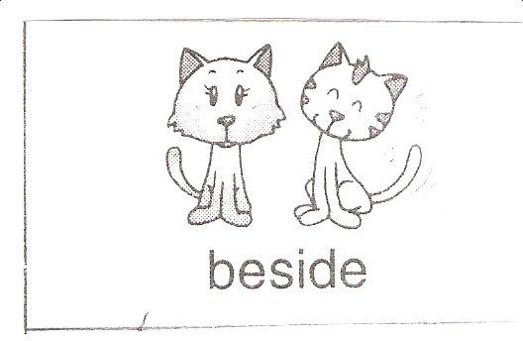
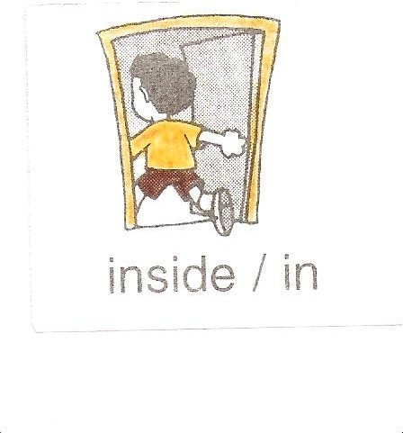
Prepositions are words that we use before nouns or pronouns to show their relationship with other words in a sentence.
Eg: I am sitting on a chair.
I am walking to her.
He sat on the chair.
There is some milk in the fridge

Slide 35
Poll Question:-
What is a preposition? Select the best definition.
A. A preposition replaces noun in a sentence.
B. A preposition names a person, creature, place, thing, feeling, quality or idea in a sentence.
C. A preposition sits before a noun (or a pronoun) to show the relationship of a noun or a pronoun to another word in the sentence
D. A preposition begins a phrase that adds meaning to a verb.

Slide 36
Answer
OPTION-C

Slide 37
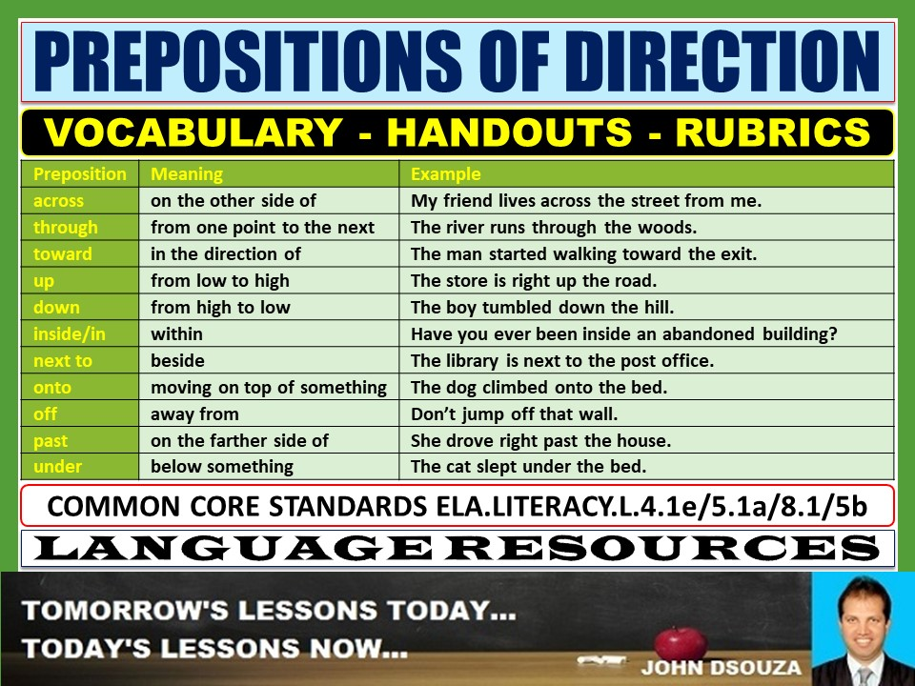
PREPOSITIONS OF DIRECTION
Prepositions of direction are used to show direction of movement to and from a fixed point
Eg: to, from, into, along, over, through, across and around..

Slide 38
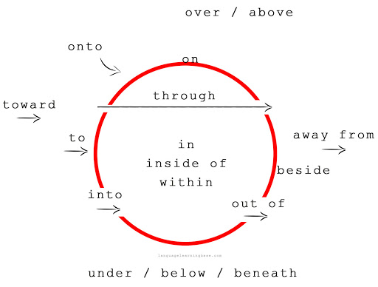
Examples:-

Slide 39
Poll Question:-
Find the preposition: Alexa walked through the door.
A. walked
B. door
C. through
D. the

Slide 40
Answer
OPTION- C

Slide 41
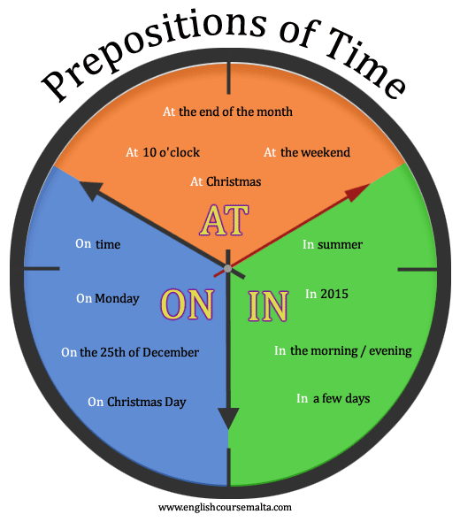
To refer to one point in time, use the prepositions "in," "at," and "on."
Use "in" with parts of the day (not specific times), months, years, and seasons.
Use "at" with the time of day. Also use "at" with noon, night, and midnight.
Use "on" with days.

Slide 42
Poll Question:-
The park opens __________ 9.30 every morning and closes _____ 6.45
A. at/on
B. on/on
C. at/in
D. at/at

Slide 43
Answer
Option-D

Slide 44
To refer to extended time, use the prepositions "since," "for," "by," "during," "from…to," "from…until," "with," and "within."
I have lived in Minneapolis since 2005. (I moved there in 2005 and still live there.)
He will be in Toronto for 3 weeks. (He will spend 3 weeks in Toronto.)
She will finish her homework by 6:00. (She will finish her homework sometime between now and 6:00.)
He works part time during the summer. (For the period of time throughout the summer.)
I will collect data from January to June. (Starting in January and ending in June.)
They are in school from August until May. (Starting in August and ending in May.)
She will graduate within 2 years. (Not longer than 2 years.)

Slide 45
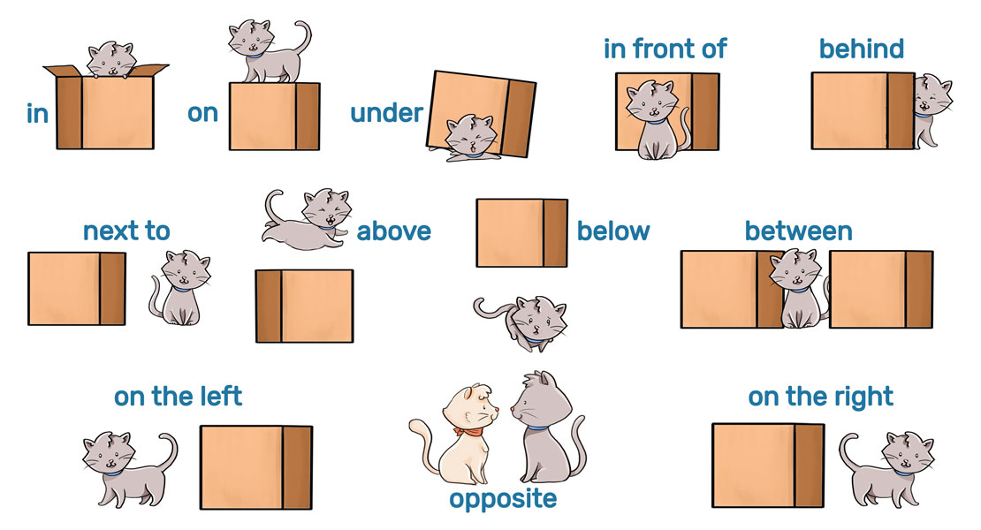
Prepositions of PLACE
Prepositions of place are used to show the position or location of one thing in the relation to other.

Slide 46
Poll Question:-
Which list contains only prepositions?
A. five, red, sweet, angry
B. yesterday, frequently, here, cup
C. good, boring, worse, nice
D. above, under, towards, outside

Slide 47
Answer
OPTION- D

Slide 48
Prepositions of PLACE
To refer to a place, use the prepositions "in" (the point itself), "at" (the general vicinity), "on" (the surface), and "inside" (something contained).
They will meet in the lunchroom.
She was waiting at the corner.
He left his phone on the bed.

Slide 49
To refer to an object higher than a point, use the prepositions "over" and "above." To refer to an object lower than a point, use the prepositions "below," "beneath," "under," and "underneath."
The bird flew over the house.
The plates were on the shelf above the cups.
Basements are dug below ground.

Slide 50
To refer to an object close to a point, use the prepositions "by," "near," "next to," "between," "among," and "opposite.“
The gas station is by the grocery store.
The park is near her house.
Park your bike next to the garage.
There is a deer between the two trees.
There is a purple flower among the weeds.
The garage is opposite the house

Slide 51
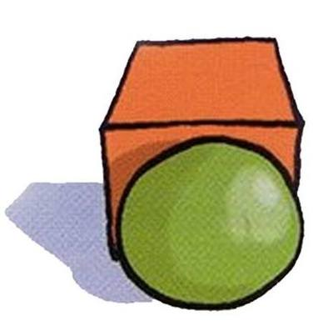
Poll Question
The green ball is …………
A. in front of the box
B. under the box
C. in the box
D. behind the box

Slide 52
Answer
OPTION- A

Slide 53
Activity-
Make Students presenter and tell them to choose the correct option.

Slide 54
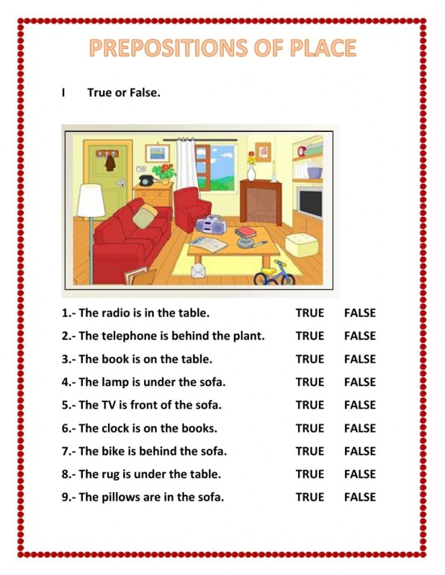

Slide 55
Prepositions of Spatial Relationships- To refer to a spatial relationship, use the prepositions
"above," "across," "against," "ahead of," "along," "among," "around," "behind," "below," "beneath," "besides," "between," "from," "in front of," "inside," "near," "off," "out of," "through," "toward," "under," and "within.“
The post office is across the street from the grocery store.
We will stop at many attractions along the way.
The kids are hiding behind the tree.
His shirt is off.
Place a check mark within the box.

Slide 56
Poll Question:-
Which of the following is not a preposition?
A. Among
B. All
C. With
D. By

Slide 57
Answer
OPTION- B

Slide 58
Some Common Verb + Preposition Combinations
About: worry, complain, read
He worries about the future.
She complained about the homework.
I read about the flooding in the city.
At: arrive (a building or event), smile, look
He arrived at the airport 2 hours early.
The children smiled at her.
She looked at him.

Slide 59
Some Common Verb + Preposition Combinations
From: differ, suffer
The results differ from my original idea.
She suffers from dementia.
For: account, allow, search
Be sure to account for any discrepancies.
I returned the transcripts to the interviewees to allow for revisions to be made.
They are searching for the missing dog.

Slide 60
Poll Question:-
"My mom got upset with me because I was up past my bedtime" How many prepositions are there?
A. 1
B. 2
C. 3
D. 0

Slide 61
Answer
OPTION- B

Slide 62
Some Common Verb + Preposition Combinations
In: occur, result, succeed
The same problem occurred in three out of four cases.
My recruitment strategies resulted in finding 10 participants.
She will succeed in completing her degree.
Of: approve, consist, smell
I approve of the idea.
The recipe consists of three basic ingredients.
The basement smells of mildew.

Slide 63
Some Common Verb + Preposition Combinations
On: concentrate, depend, insist
He is concentrating on his work.
They depend on each other.
I must insist on following this rule.
To: belong, contribute, lead, refer
Bears belong to the family of mammals.
I hope to contribute to the previous research.
My results will lead to future research on the topic.
Please refer to my previous explanation.
With: (dis)agree, argue, deal
I (dis)agree with you.
She argued with him.
They will deal with the situation.

Slide 64
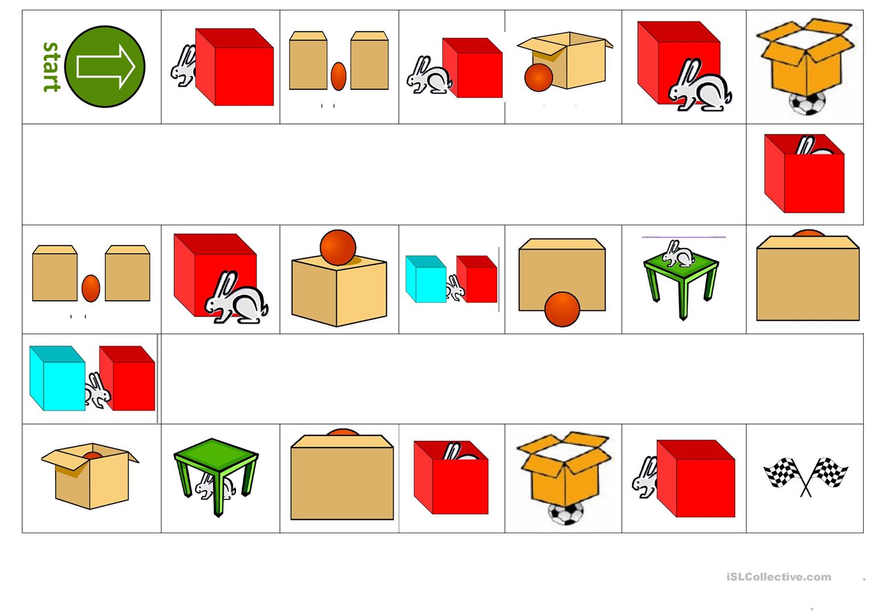
Activity- Tell he position of Ball & Rabbit

Slide 65
Poll Question:-
Visitors are asked to abstain ___________ smoking on the premises.
A. from
B. on
C. to
D. with

Slide 66
Answer
OPTION- A

Slide 67
Persist in patience – it may not happen overnight, but make good patience a habit that you practice…….”
THANK YOU

